Slide 1
Heart Disease Diagnostic Analysis
-BARNEY SOPHIA(UMIP14841)

Slide 2
Project Overview
The goal of this project is to analyze a heart disease diagnostic database, which contains essential health data and insights into heart disease incidence based on gender, age, and other key attributes.
By leveraging the power of data analysis and visualization, this project will provide an in-depth understanding of heart disease trends, key metrics, and help make better future preparations for health systems globally.

Slide 3
Dataset
age: Age of the patient
sex: Sex of the patient (1= Male, 0 = Female)
cp: Chest pain type (4 types: 3= Asymptomatic,1= Atypical Angina, 2= Non-angina pain, 0= Typical Angina)
trestbps: Resting blood pressure (in mm Hg)
chol: Serum cholesterol in mg/dl
fbs: Fasting blood sugar > 120 mg/dl (1= True, 0= False)
restecg: Resting electrocardiographic results (values 2= Lenticular Hypertrophy, 0= Normal, 1= ST-T wave Abnormality)
thalach: Maximum heart rate achieved
exang: Exercise-induced angina (1= Yes; 0= No)
oldpeak: ST depression induced by exercise relative to rest
slope: The slope of the peak exercise ST segment
ca: Number of major vessels (0-3) colored by fluoroscopy
thal: Thalassemia (0= Normal; 1= Fixed defect; 2= Reversible defect 3=No )
target: Presence of heart disease (0= Yes, 1= No)

Slide 4
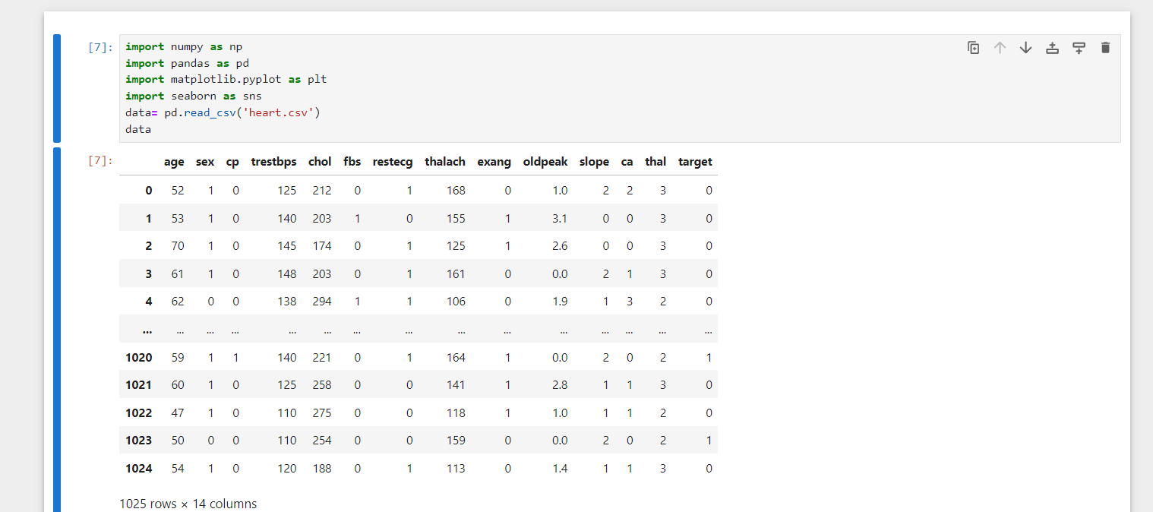
Importing Libraries and Modules

Slide 5
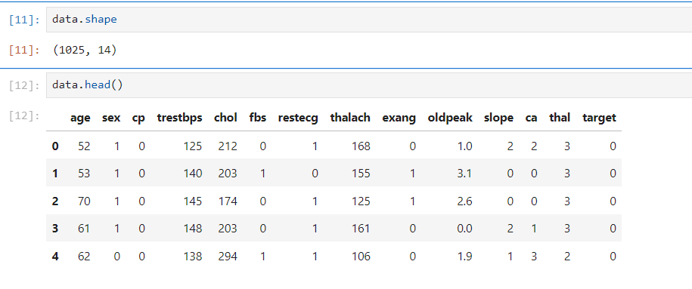
Data Understanding

Slide 6
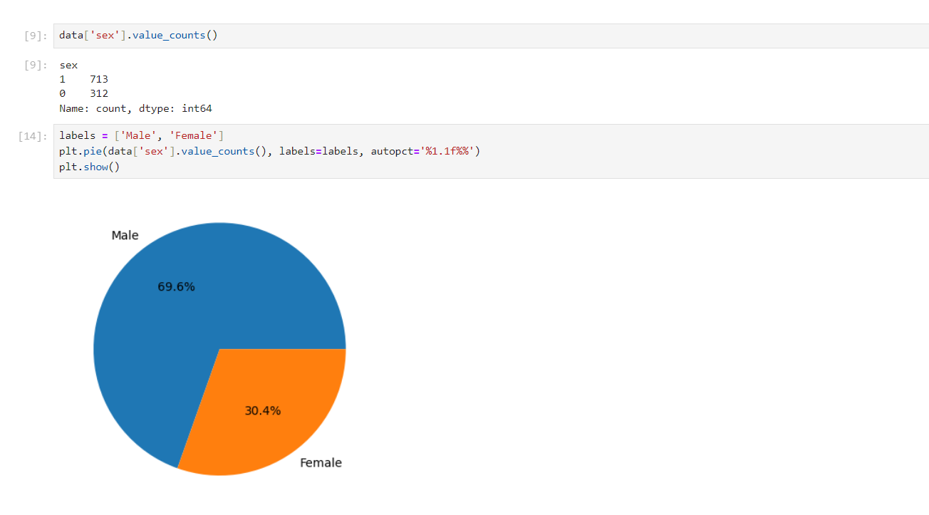
Gender Distribution
Based on the heart disease dataset:
Males = 713(69.6%)
Females = 312(30.4%)

Slide 7
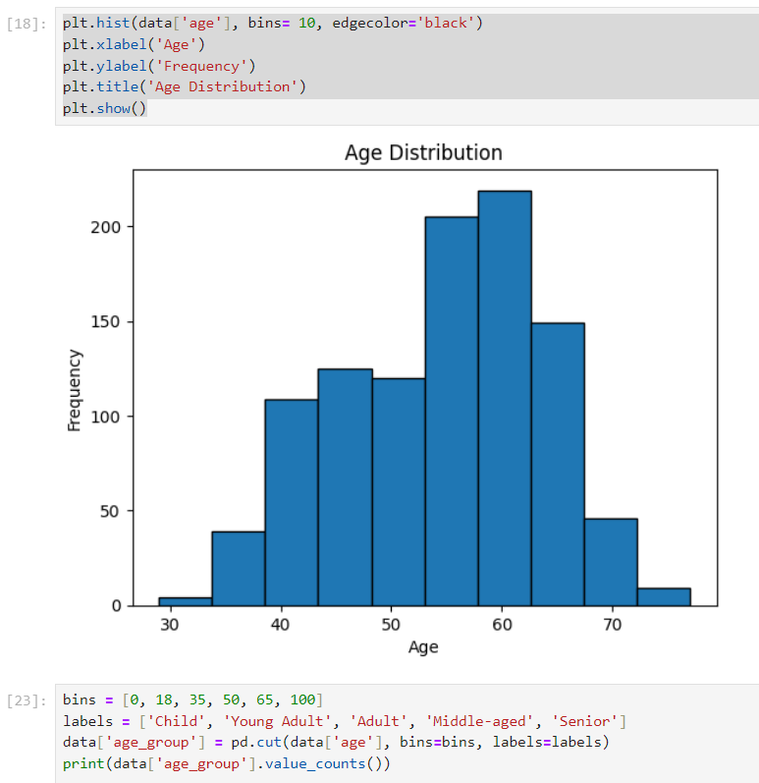
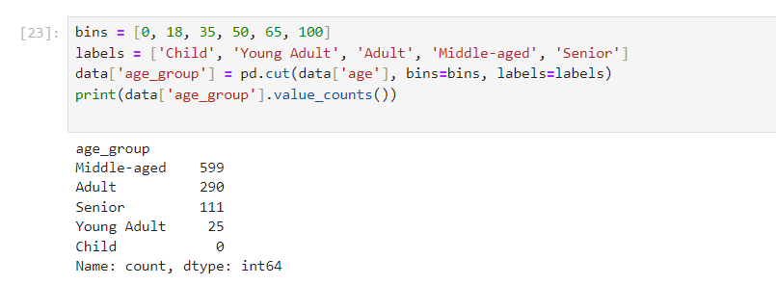
Age Distribution

Slide 8
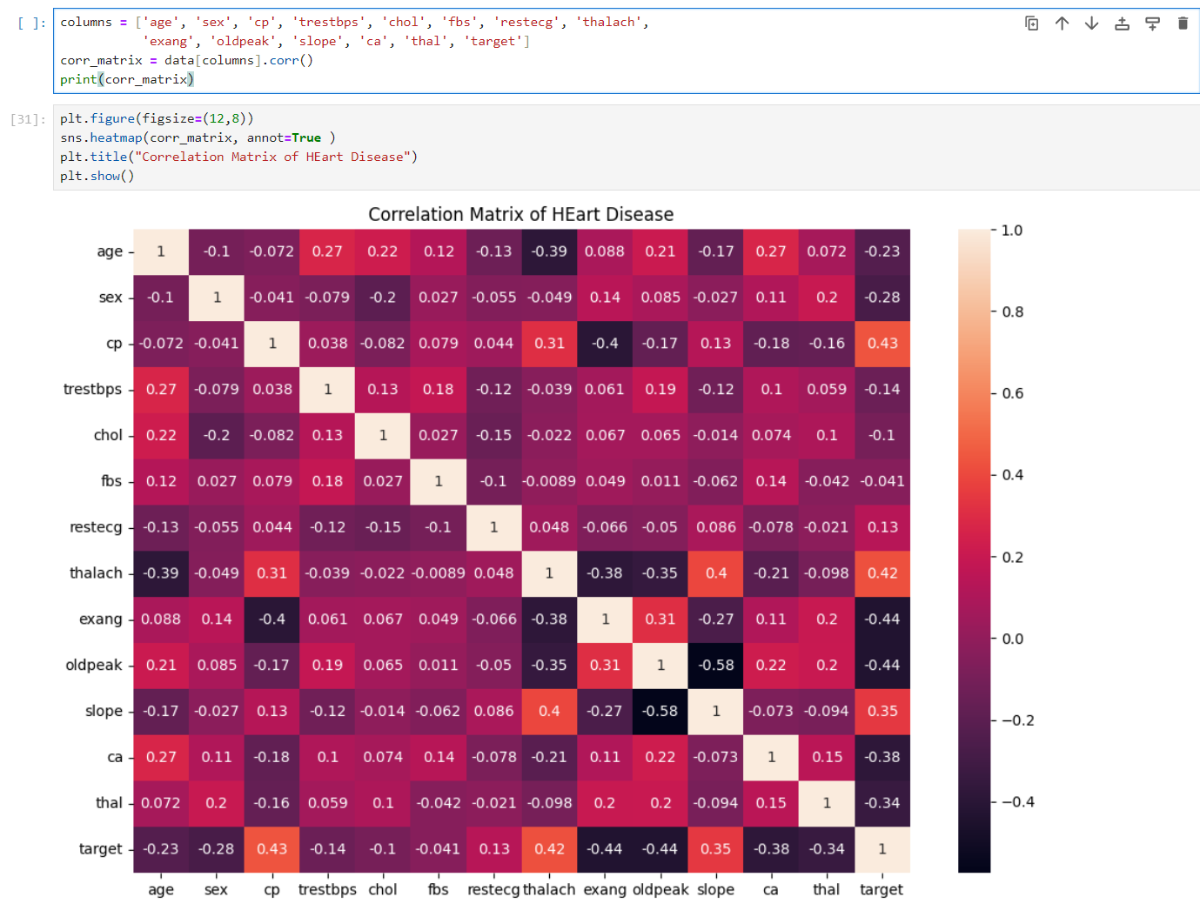
Correlation Matrix of Heart Disease
Thalassemia (thal) → -0.34
- Certain blood disorders lower risk
Number of Major Vessels (ca) → + 0.27
-More blocked vessels = higher heart disease risk
ST Slope (slope) → +0.35
-Abnormal slope indicates heart disease
Chest Pain Type (cp) → +0.43
-More chest pain = higher heart disease risk

Slide 9
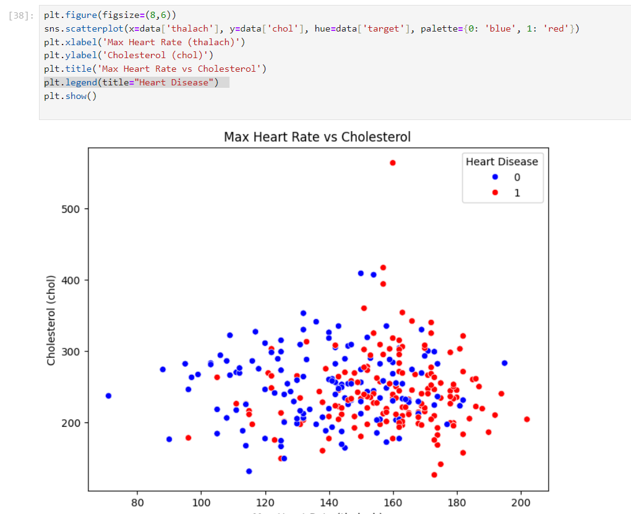
Heart Rate vs Cholestrol
Cholesterol and max heart rate alone do not definitively indicate heart disease; individuals with and without heart disease show a wide range of values.
Some individuals with very high cholesterol levels don't have heart disease, suggesting other factors also play significant roles in heart disease risk.

Slide 10
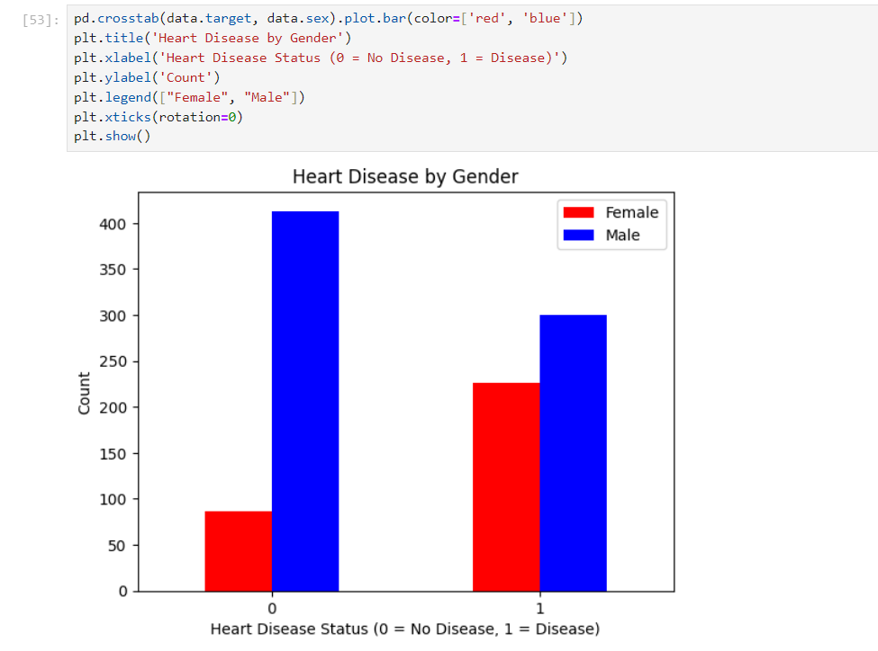
Heart Disease by Gender
Males are more prominently affected by heart disease, though both genders are impacted.

Slide 11
Power BI Dashboard

Slide 12
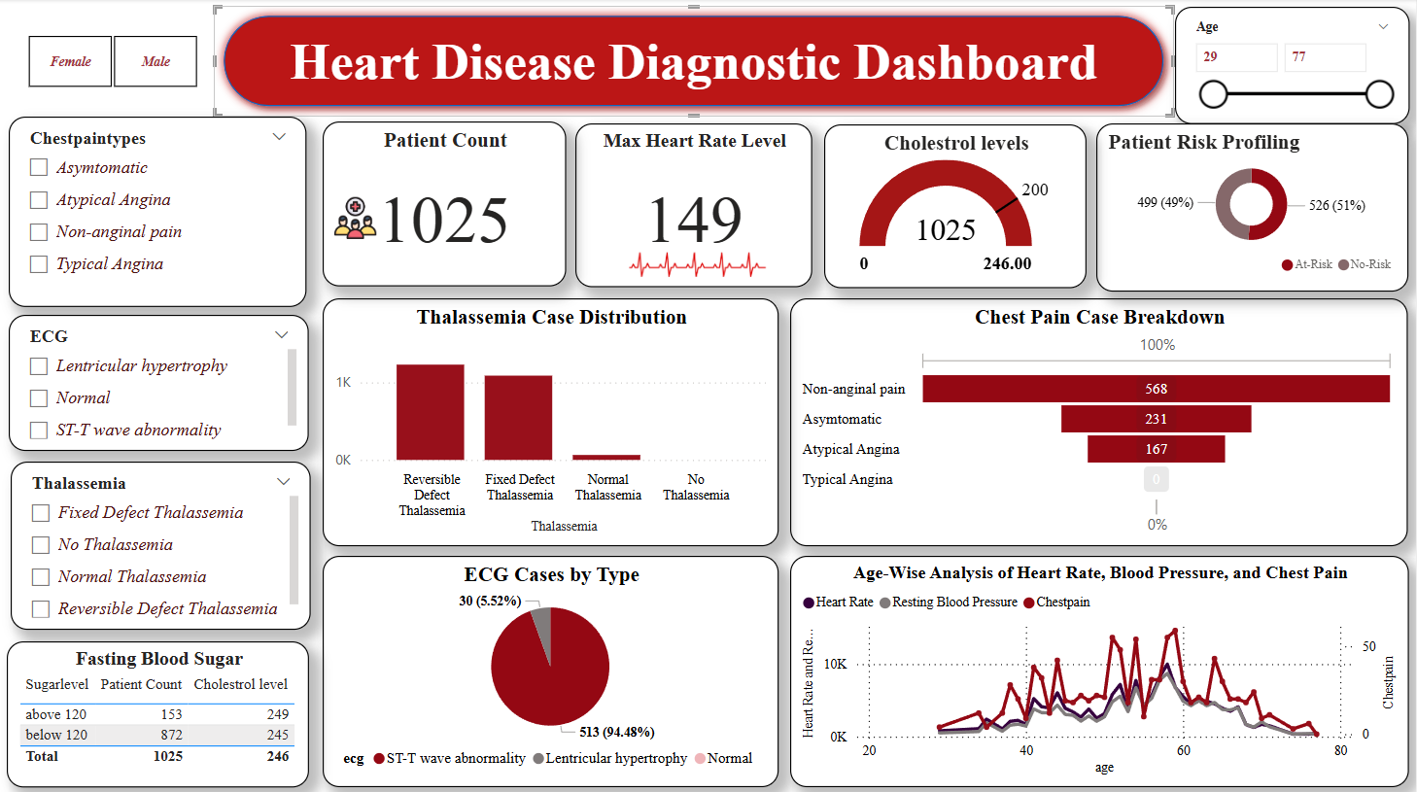

Slide 13
Key Insights
The average age of the patients is 54. Majority of the patients are male and the common type of chest pain experienced is the Typical Angina.
About half (49%) of the patients are categorized as "No-Risk," while the other half (51%) are "At-Risk." This indicates a balanced distribution, emphasizing the importance of monitoring and preventative measures for at-risk individuals..
Elevated blood pressure is a well-known risk factor for heart disease, and it's important to monitor and manage it to reduce overall risk.
High fasting blood sugar levels diabetes(153 patients) are indicative of which significantly increases the risk of heart disease.
The average Cholesterol Level is 246mg/dL High cholesterol levels are a known risk factor for heart disease, and monitoring and managing cholesterol through diet, exercise, and medication is crucial for heart health.
The results of thallium stress tests indicate how well blood is flowing to the heart muscle. Abnormal results can point to blockages or other issues that need to be addressed.

Slide 14
Recommendations:
Ensure regular monitoring of fasting blood sugar and cholesterol levels. Keeping track of these metrics helps in early detection and management of any abnormalities.
If prescribed medications to manage blood sugar or cholesterol levels. Consult with a healthcare provider for any concerns or adjustment

